Slide 1
Utilitarianism
Copyright © 2019 Hal R. Varian

Slide 2
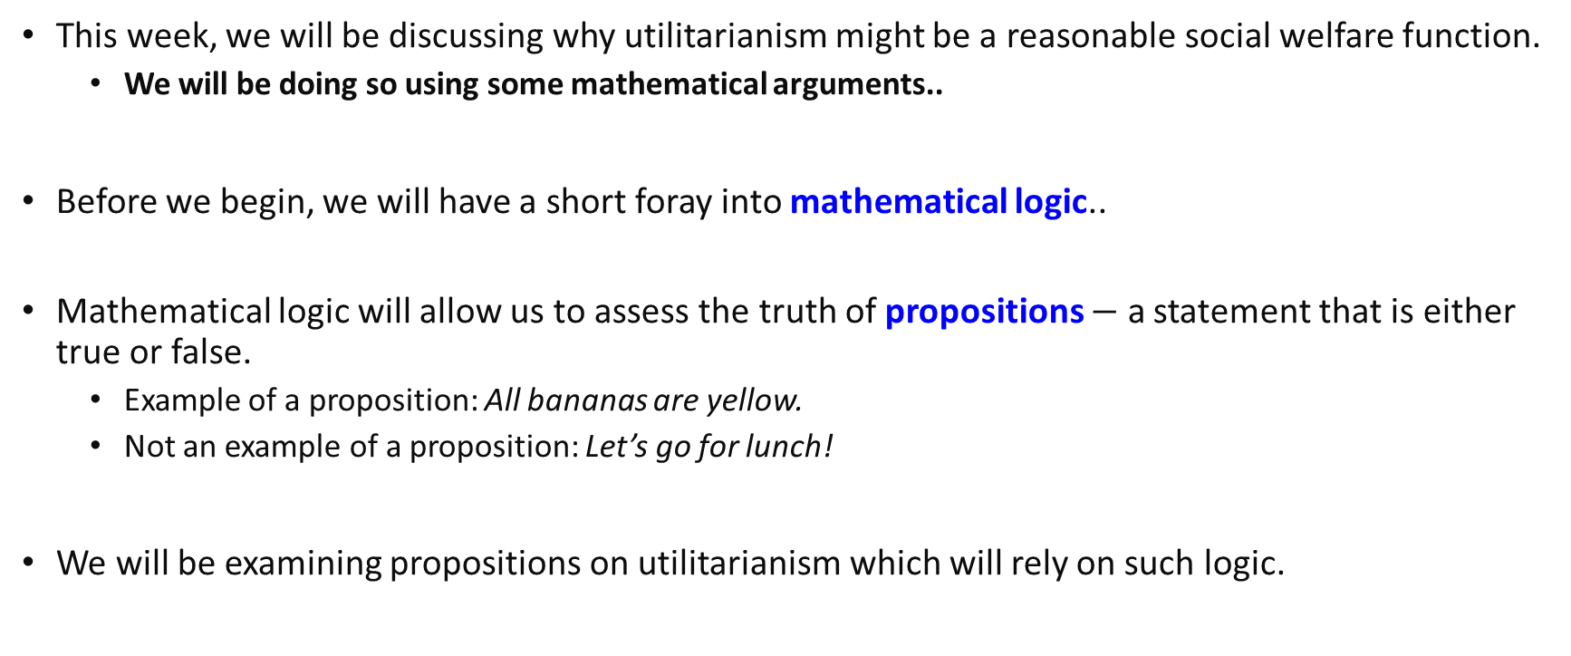
Introduction
This week, we will be discussing why utilitarianism might be a reasonable social welfare function.
We will be doing so using some mathematical arguments..
Before we begin, we will have a short foray into mathematical logic..
Mathematical logic will allow us to assess the truth of propositions $−$ a statement that is either true or false.
Example of a proposition: All bananas are yellow.
Not an example of a proposition: Let’s go for lunch!
We will be examining propositions on utilitarianism which will rely on such logic.

Slide 3
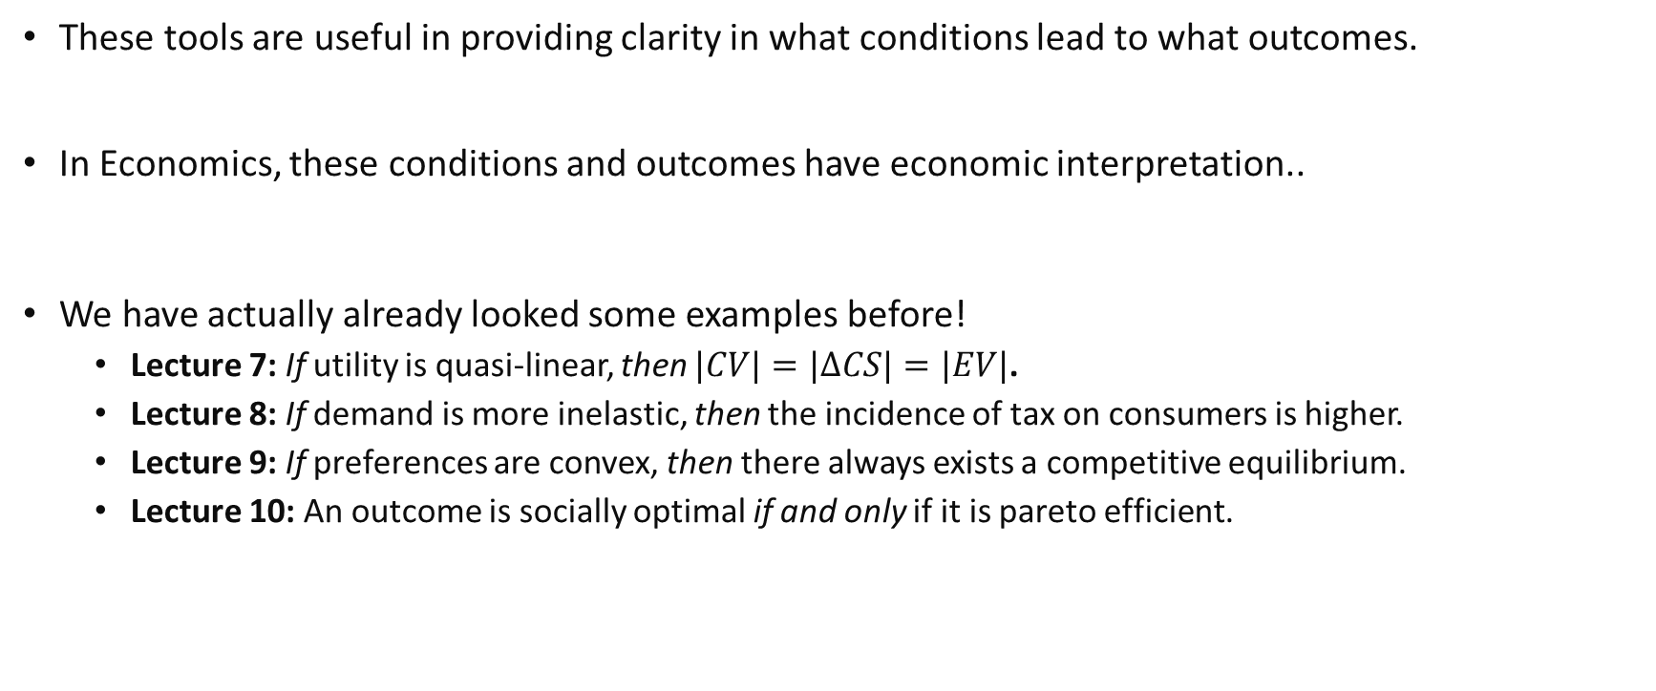
Mathematical Logic
These tools are useful in providing clarity in what conditions lead to what outcomes.
In Economics, these conditions and outcomes have economic interpretation..
We have actually already looked some examples before!
Lecture 7: If utility is quasi-linear, then $|CV|=|ΔCS|=|EV|$.
Lecture 8: If demand is more inelastic, then the incidence of tax on consumers is higher.
Lecture 9: If preferences are convex, then there always exists a competitive equilibrium.
Lecture 10: An outcome is socially optimal if and only if it is pareto efficient.

Slide 4
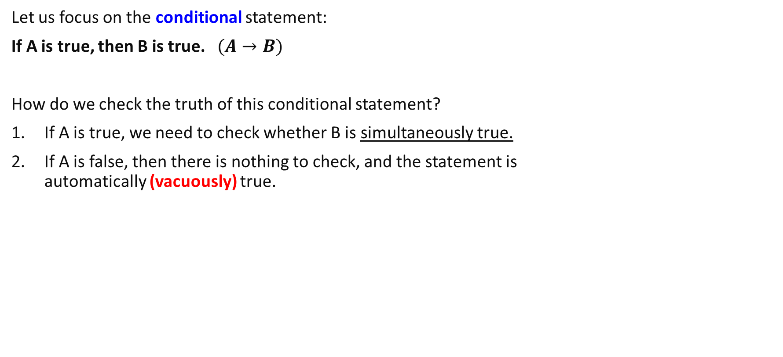
Conditional Statements
Let us focus on the conditional statement:
If A is true, then B is true. $(A→B)$
How do we check the truth of this conditional statement?
If A is true, we need to check whether B is simultaneously true.
If A is false, then there is nothing to check, and the statement is automatically (vacuously) true.

Slide 5
Review Question
Are the following statements true (in our world)?
If a fruit is yellow, then it is (always) a banana.
If an elephant is orange in color, then it can fly.

Slide 6

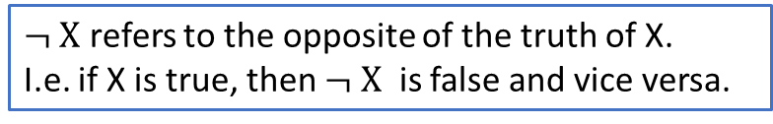
Conditional Statements & Contrapositive
If A is true, then B is true. $(A→B)$
An equivalent way to state this is the contrapositive of the statement:
If B is not true, then A is not true. $\left(¬ B→¬A\right)$
In any possible state of the world, both A and B are either true or false.
State 1: A is true, B is true. State 2: A is true, B is false. State 3: A is false, B is true. State 4: A is false, B is false.
The two statements are equivalent if in all states of the world, the truth of both statements is the same. I.e. they are saying the same thing all the time!
$¬ X$ refers to the opposite of the truth of X.
I.e. if X is true, then $¬ X$ is false and vice versa.

Slide 7
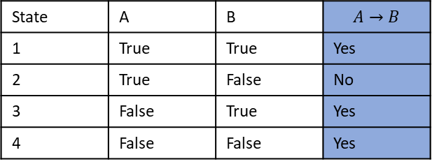

Conditional Statements & Contrapositive
Why are the statements the same, logically?
Let us consider all 4 different states of the world for A and B and in each case, what is the truth of the statement “if A is true, then B is true”?
How about the truth of the statement “if B is not true, then A is not true”?
State | A | B | $$A→B$$
1 | True | True | Yes
2 | True | False | No
3 | False | True | Yes
4 | False | False | Yes
State | $$¬A$$ | $$¬B$$ | $$¬ B→¬A$$
1 | False | False | Yes
2 | False | True | No
3 | True | False | Yes
4 | True | True | Yes
In all states of the world, the truth of both statements is the same!
Notes:
In state 1 of the world, A->B is true.
In state 2 of the world…

Slide 8
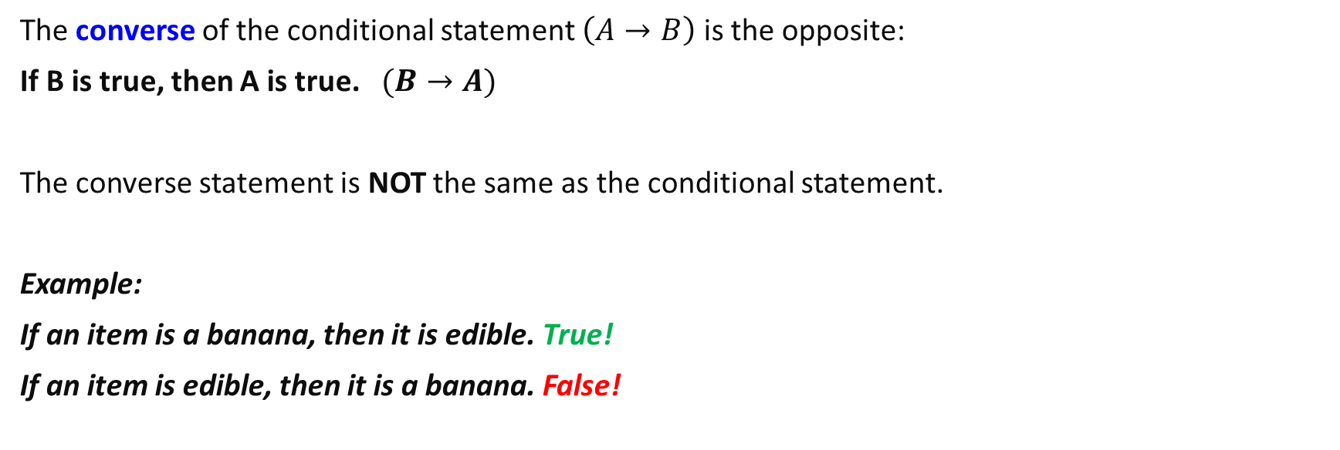
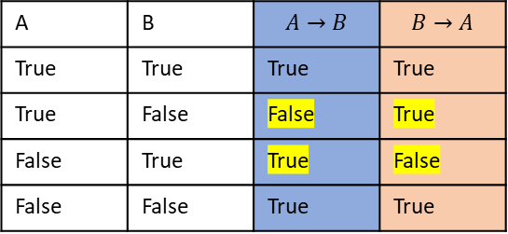
Conditional Statements & Converse
The converse of the conditional statement $\left(A→B\right)$ is the opposite:
If B is true, then A is true. $(B→A)$
The converse statement is NOT the same as the conditional statement.
Example:
If an item is a banana, then it is edible. True!
If an item is edible, then it is a banana. False!
A | B | $$A→B$$ | $$B→A$$
True | True | True | True
True | False | False | True
False | True | True | False
False | False | True | True

Slide 9
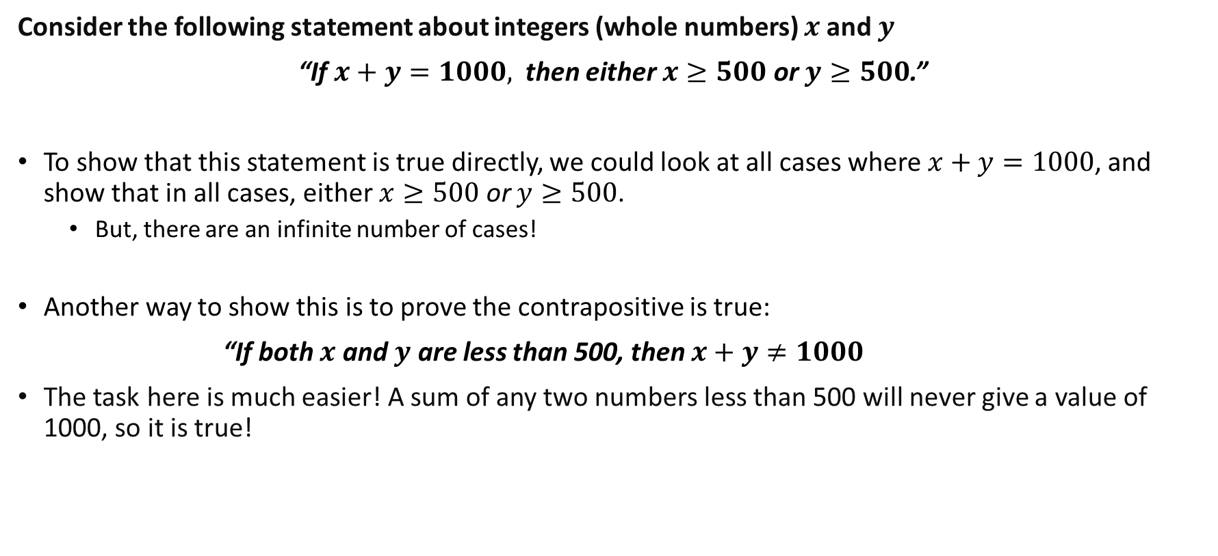
Why is mathematical logic useful?
Consider the following statement about integers (whole numbers) $x$and $y$
“If $x+y=1000,$ then either $x≥500$ or $y≥500$.”
To show that this statement is true directly, we could look at all cases where $x+y=1000$, and show that in all cases, either $x≥500$ or $y≥500$.
But, there are an infinite number of cases!
Another way to show this is to prove the contrapositive is true:
“If both $x$ and $y$ are less than 500, then $x+y≠1000$
The task here is much easier! A sum of any two numbers less than 500 will never give a value of 1000, so it is true!
Notes:
The opposite of saying that either X or Y is true is saying that both are false.

Slide 10

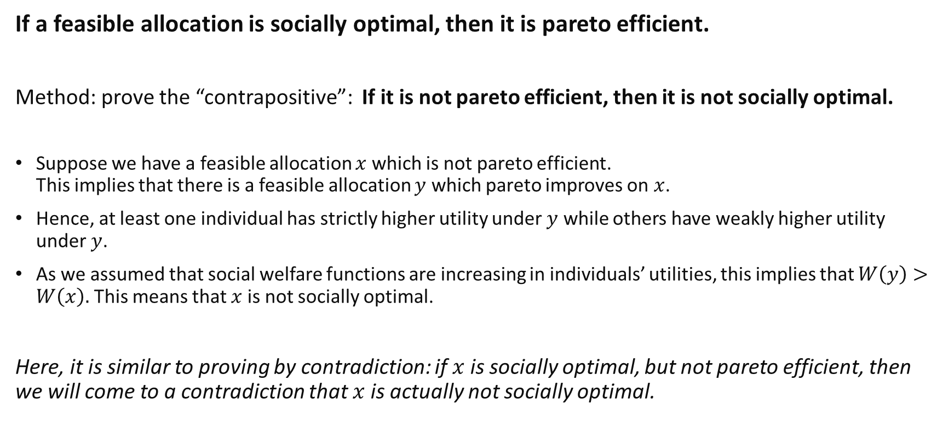
Example: Social Optima $→$ Pareto Efficiency
If a feasible allocation is socially optimal, then it is pareto efficient.
Method: prove the “contrapositive”: If it is not pareto efficient, then it is not socially optimal.
Suppose we have a feasible allocation $x$ which is not pareto efficient. This implies that there is a feasible allocation $y$ which pareto improves on $x$.
Hence, at least one individual has strictly higher utility under $y$ while others have weakly higher utility under $y$.
As we assumed that social welfare functions are increasing in individuals’ utilities, this implies that $W\left(y\right)>W\left(x\right).$This means that $x$ is not socially optimal.
Here, it is similar to proving by contradiction: if $x$ is socially optimal, but not pareto efficient, then we will come to a contradiction that $x$ is actually not socially optimal.
Notes:
Proving is done by using a sequence of logical arguments.

Slide 11
Continuing on with Social Welfare Functions..

Slide 12
Introduction
Last week, we considered making social choices
To choose between different pareto efficient allocations, one reasonable way would be to use a social welfare function…
However, what social welfare function is the “correct” one?
This is a difficult question to answer, with different arguments in moral philosophy.
Two commonly discussed SWFs are the Rawlsian SWF and Utilitarian SWF.

Slide 13
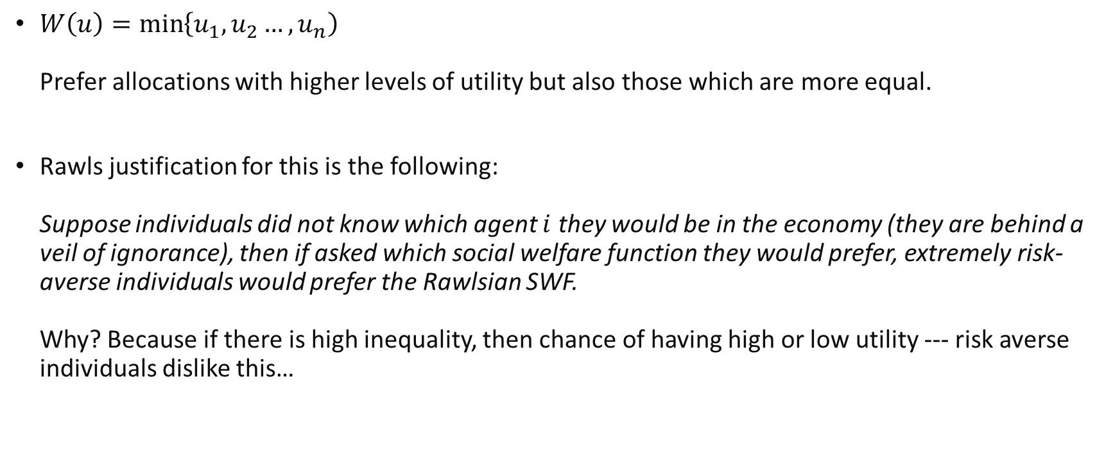
Rawlsian Social Welfare Function
$W\left(u\right)=\min\left\{u_{1},u_{2}…, u_{n}\right)$ Prefer allocations with higher levels of utility but also those which are more equal.
Rawls justification for this is the following: Suppose individuals did not know which agent $i$ they would be in the economy (they are behind a veil of ignorance), then if asked which social welfare function they would prefer, extremely risk-averse individuals would prefer the Rawlsian SWF. Why? Because if there is high inequality, then chance of having high or low utility --- risk averse individuals dislike this…

Slide 14
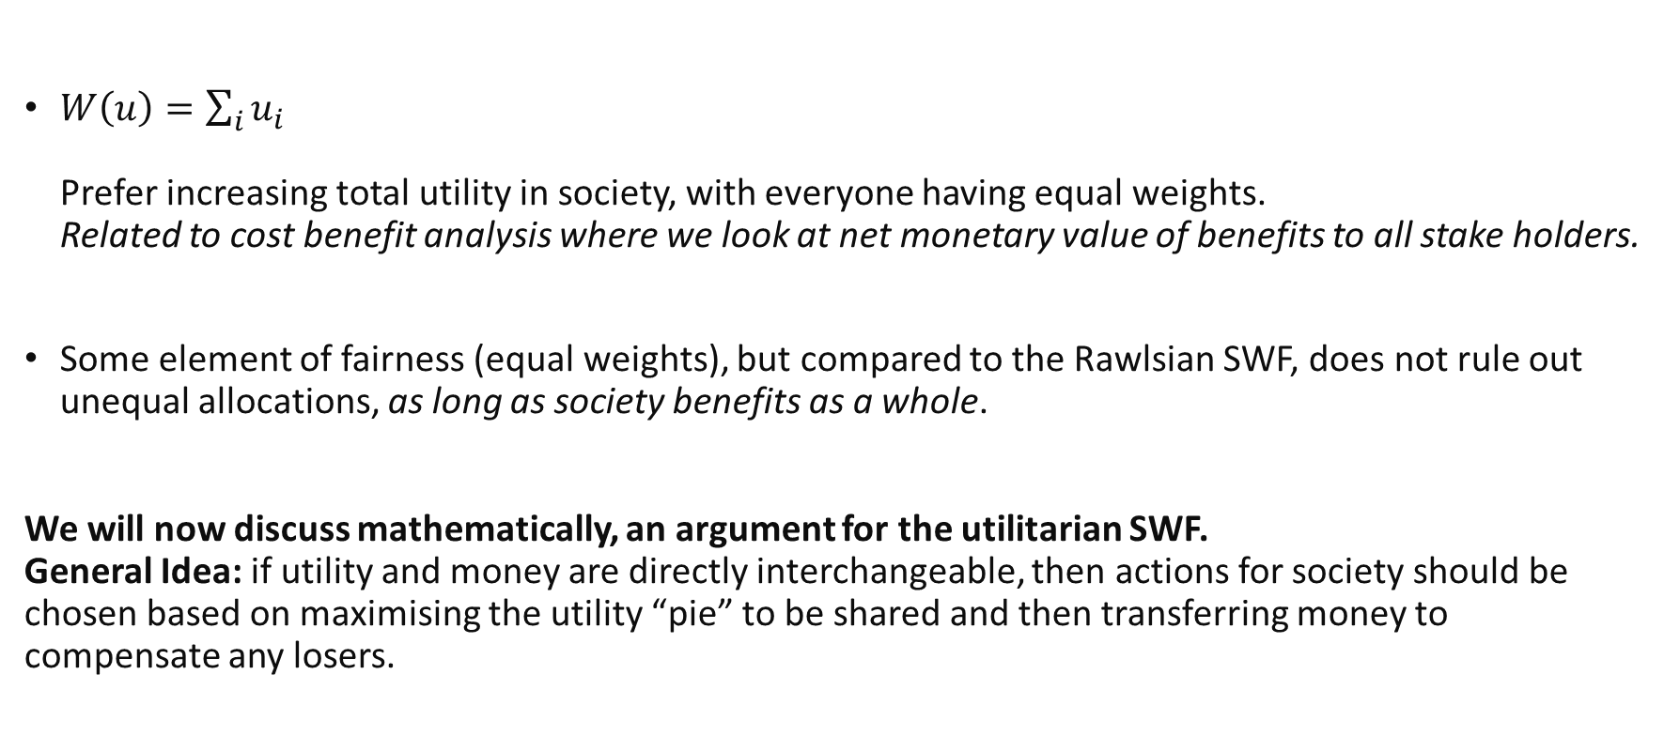
Utilitarian Social Welfare Function
$W\left(u\right)=\sum_{i}{u_{i}}$ Prefer increasing total utility in society, with everyone having equal weights. Related to cost benefit analysis where we look at net monetary value of benefits to all stake holders.
Some element of fairness (equal weights), but compared to the Rawlsian SWF, does not rule out unequal allocations, as long as society benefits as a whole.
We will now discuss mathematically, an argument for the utilitarian SWF. General Idea: if utility and money are directly interchangeable, then actions for society should be chosen based on maximising the utility “pie” to be shared and then transferring money to compensate any losers.

Slide 15
Augmenting Social Choice with Money Transfers

Slide 16
Social Choices without Money Transfers. An Example…
As an example, let’s consider how to assign a movie ticket between Joseph and Ivy (who both like watching movies).
Suppose our only problem was to decide who to allocate the ticket without any transfers of money.
Without money transfers, any allocation of the movie ticket is Pareto efficient.
For example, taking the movie ticket away from Joseph and giving it to Ivy will make Joseph strictly worse off.

Slide 17
Social Choices with Money Transfers An Example…
Now, consider a scenario which also allows for monetary transfers in our social choice problem. We assume that consumers care directly about money held.
This is a simplifying assumption which accounts for consumers possibly valuing goods not present in the model which can be purchased with money.
Effectively, this means we are introducing a new good: money. We are hence changing the economic conditions.
We need to consider how this affects which allocations are pareto efficient.
A relevant question: How much money are they willing to pay for the movie ticket?
Notes:
The WTP is like their reservation price.

Slide 18
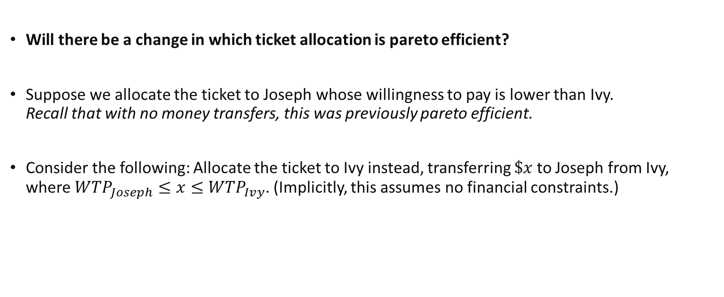
Social Choices with Money Transfers An Example…
Will there be a change in which ticket allocation is pareto efficient?
Suppose we allocate the ticket to Joseph whose willingness to pay is lower than Ivy. Recall that with no money transfers, this was previously pareto efficient.
Consider the following: Allocate the ticket to Ivy instead, transferring $\$x$ to Joseph from Ivy, where ${WTP}_{Joseph}≤x{≤WTP}_{Ivy}$. (Implicitly, this assumes no financial constraints.)
Notes:
Hence, we have reduced the set of pareto efficient equilibrium to the “most efficient one”
Note, if the allocation was not pareto efficient before, then it would not be pareto efficient with social transfers.

Slide 19

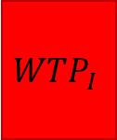

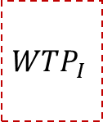

Social Choices with Money Transfers An Example…
Joseph
Ivy
Joseph
Ivy
Cash
Cash
Cash
Cash
$$WTP_{I}$$
$$WTP_{J}$$
$$WTP_{I}$$
+$x$
Initial: Joseph gets ticket.
After: Ivy gets ticket and pays Joseph $x$.
This Pareto dominates the initial allocation of the ticket as both are better off!
When money is involved, pareto efficiency must involve allocating the ticket to the person with the highest willingness to pay! I.e. It is utilitarian!
Notes:
Hence, we have reduced the set of pareto efficient equilibrium to the “most efficient one”
Note, if the allocation was not pareto efficient before, then it would not be pareto efficient with social transfers.

Slide 20
A Model of Social Choice with Money Transfers

Slide 21
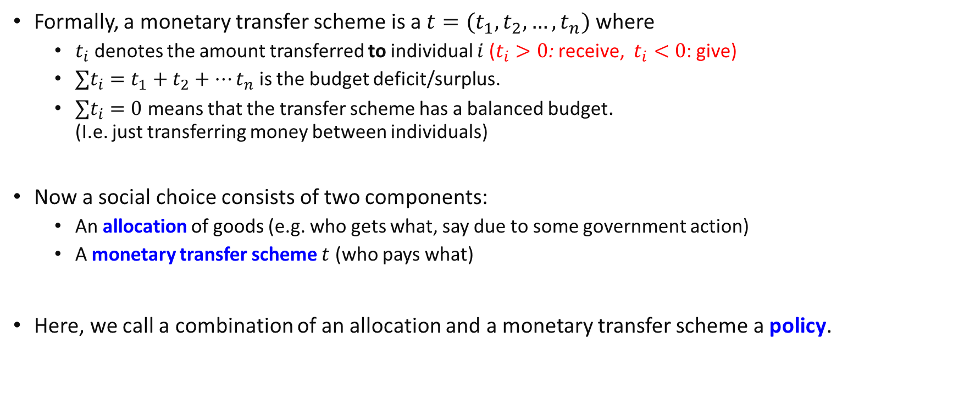
Social Choice with Money Transfers
Formally, a monetary transfer scheme is a $t=(t_{1},t_{2},…,t_{n})$ where
$t_{i}$ denotes the amount transferred to individual $i$ ($t_{i}>0$: receive, $t_{i}<0$: give)
$∑t_{i}=t_{1}+t_{2}+…t_{n}$ is the budget deficit/surplus.
$∑t_{i}=0$ means that the transfer scheme has a balanced budget. (I.e. just transferring money between individuals)
Now a social choice consists of two components:
An allocation of goods (e.g. who gets what, say due to some government action)
A monetary transfer scheme $t$ (who pays what)
Here, we call a combination of an allocation and a monetary transfer scheme a policy.
Notes:
Now we are going to show this formally.

Slide 22
Social Choice with Money Transfers
We will now show formally that any pareto efficient policy must involve a utilitarian allocation.
Key assumption:
Money is not only for exchange purposes, but is also directly valued, perhaps because it can be kept to purchase other things currently not available in the economy.
In particular, utility is assumed to be quasi-linear in money..
From Lecture 7, this implies that utility from goods is directly exchangeable with money!
Essentially, it also allows utility to be directly traded via monetary transfers.

Slide 23
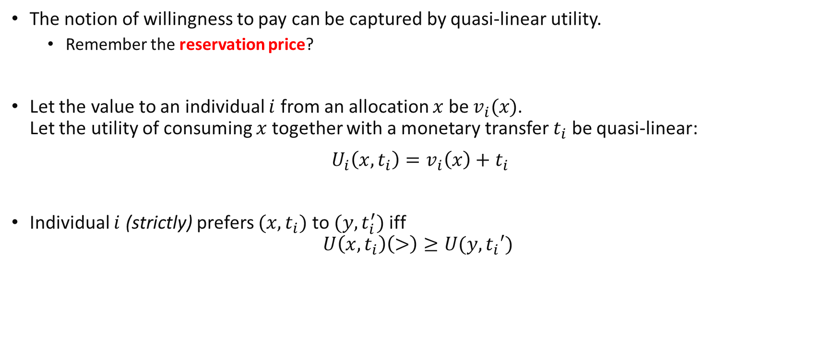
Quasi Linear utility and willingness to pay
The notion of willingness to pay can be captured by quasi-linear utility.
Remember the reservation price?
Let the value to an individual $i$ from an allocation $x$ be $v_{i}(x)$. Let the utility of consuming $x$ together with a monetary transfer $t_{i}$ be quasi-linear:
${U_{i}\left(x,t_{i}\right)=v}_{i}\left(x\right)+t_{i}$
Individual $i$ (strictly) prefers $(x,t_{i})$ to $(y,t_{i}^{′})$ iff $U\left(x,t_{i}\right)\left(>\right)≥U(y,t_{i}′)$

Slide 24
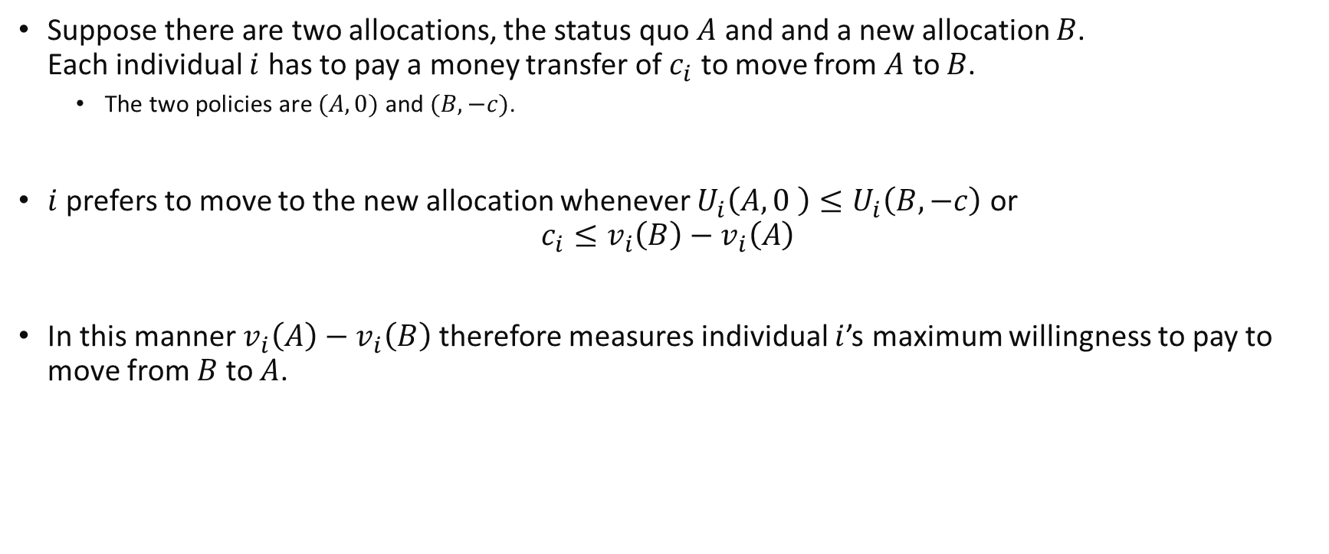
Quasi Linear utility and willingness to pay
Suppose there are two allocations, the status quo $A$ and and a new allocation $B$. Each individual $i$ has to pay a money transfer of $c_{i}$ to move from $A$ to $B$.
The two policies are $(A,0)$ and $(B,−c)$.
$i$ prefers to move to the new allocation whenever $U_{i}\left(A,0 \right)≤U_{i}\left(B,−c\right)$ or
$$c_{i}≤v_{i}\left(B\right)−v_{i}\left(A\right)$$
In this manner $v_{i}\left(A\right)−v_{i}\left(B\right)$ therefore measures individual $i$’s maximum willingness to pay to move from $B$ to $A$.
Notes:
New allocation with associated transfer.

Slide 25

Utilitarianism and Pareto Efficiency $−$ A Preview..
Earlier, we talked about how with transfers, a pareto efficient outcome should allocate items to people who have the highest willingness to pay.
Under quasi-linear utility, we showed that the willingness to pay is equivalent to the utility value of getting the item.
This suggests that allowing for transfers, valuing pareto efficiency is equivalent to maximising the sum of people’s utilities (utilitarianism) when making a choice of allocations.

Slide 26
Utilitarianism = Pareto Efficiency (with money transfers)

Slide 27

Utilitarian Allocations
We call an allocation utilitarian if it maximises the utilitarian social welfare function $\sum_{i=1}^{n}{v_{i}}\left(X\right)$.
If society is utilitarian, then it (weakly) prefers an allocation A to an allocation B if and only if
$$\sum_{i=1}^{n}{v_{i}}\left(A\right)≥\sum_{i=1}^{n}{v_{i}}\left(B\right)$$
Remember that allocations do not involve money in this setting! Only policies do.. Hence, we only consider the utility which is derived from consumption of allocations $v$.
Notes:
Updated wording.

Slide 28

Pareto Efficiency with money transfers
A policy is pareto efficient if there is no other policy that pareto improves on it. (Lecture 10)
Policy$(A,t)$ pareto improves on policy $(B,t′)$ if everyone weakly prefers $(A,t)$ to $(B,t′)$ and at least one individual strictly prefers $(A,t)$ to $(B,t′)$ .
That is, $U_{i}\left(A,t_{i}\right)≥U_{i}(B,t_{i}′)$ for all individuals $i$ and $U_{i}\left(A,t_{i}\right)>U_{i}(B,t_{i}′)$ for at least one individual $i$.
In the subsequent analysis, we restrict attention to monetary transfer schemes that have a balanced budget $(∑t_{i}=0)$.
We call such transfers balanced transfers.

Slide 29
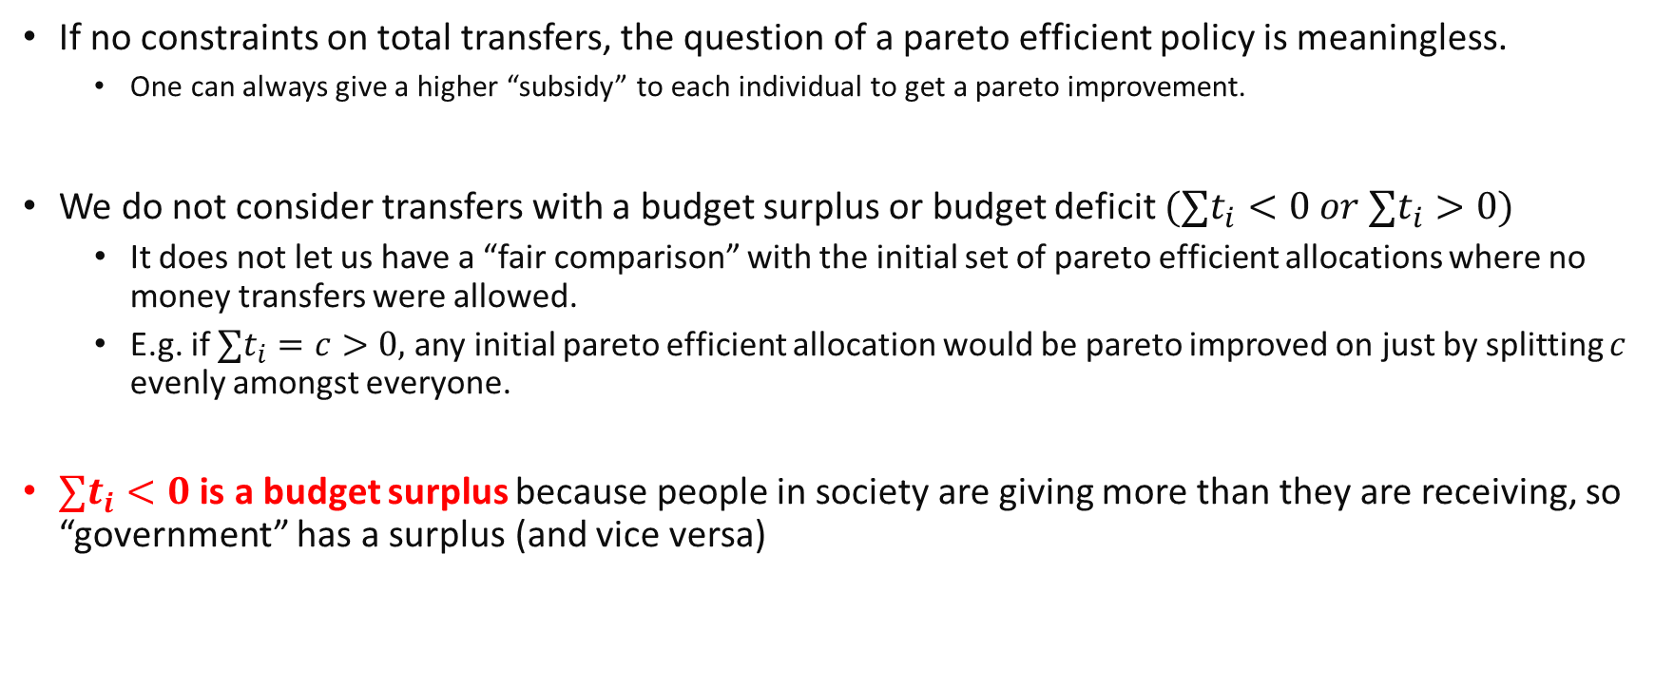
Why consider balanced money transfers?
If no constraints on total transfers, the question of a pareto efficient policy is meaningless.
One can always give a higher “subsidy” to each individual to get a pareto improvement.
We do not consider transfers with a budget surplus or budget deficit $(∑t_{i}<0 or ∑t_{i}>0)$
It does not let us have a “fair comparison” with the initial set of pareto efficient allocations where no money transfers were allowed.
E.g. if $∑t_{i}=c>0,$ any initial pareto efficient allocation would be pareto improved on just by splitting $c$ evenly amongst everyone.
$∑t_{i}<0$ is a budget surplus because people in society are giving more than they are receiving, so “government” has a surplus (and vice versa)

Slide 30
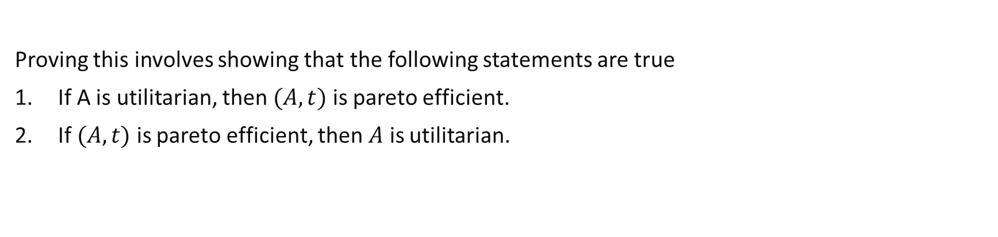
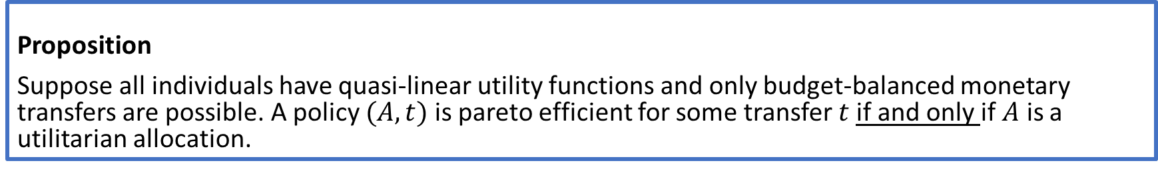
Utilitarianism and Pareto Efficiency with money transfers
Proposition
Suppose all individuals have quasi-linear utility functions and only budget-balanced monetary transfers are possible. A policy $(A,t)$ is pareto efficient for some transfer $t$if and only if $A$ is a utilitarian allocation.
Proving this involves showing that the following statements are true
If A is utilitarian, then $(A,t)$ is pareto efficient.
If $(A,t)$ is pareto efficient, then $A$ is utilitarian.
Notes:
These follow the definitions specified in the earlier boxes.

Slide 31
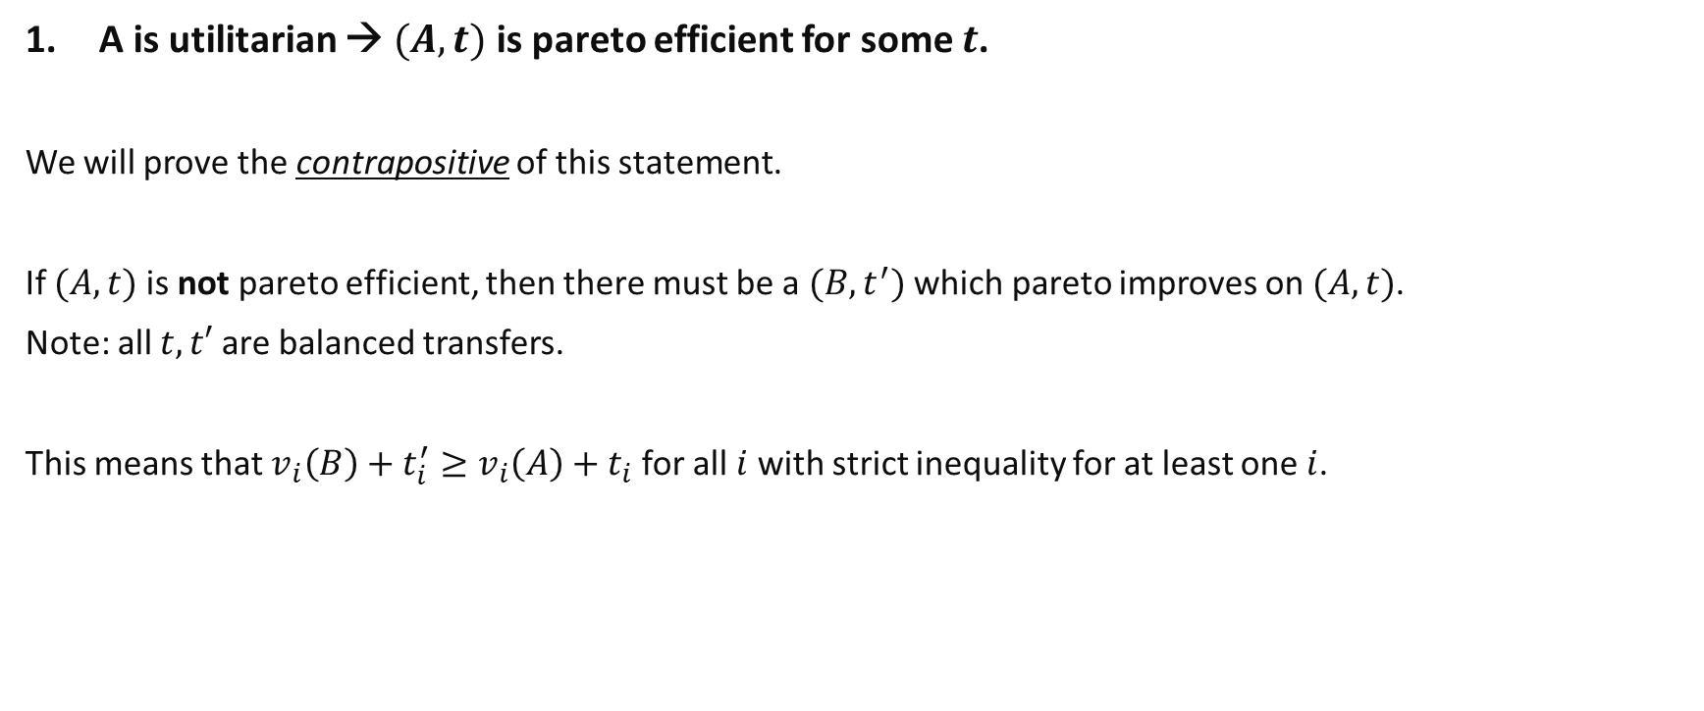
Utilitarianism and Pareto Efficiency with money transfers
A is utilitarian → $(A,t)$ is pareto efficient for some $t$.
We will prove the contrapositive of this statement.
If $(A,t)$ is not pareto efficient, then there must be a $(B,t^{′})$ which pareto improves on $(A,t)$.
Note: all $t, t′$ are balanced transfers.
This means that $v_{i}\left(B\right)+t_{i}^{′}≥v_{i}\left(A\right)+t_{i}$ for all $i$ with strict inequality for at least one $i$.

Slide 32

Utilitarianism and Pareto Efficiency with money transfers
Summing this over all individuals, we get:
$$\sum_{i=1}^{n}{v_{i}\left(B\right)+t_{i}^{′}>\sum_{i=1}^{n}{v_{i}\left(A\right)+t_{i}}}$$
$$\sum_{i=1}^{n}{v_{i}\left(B\right)+\sum_{i=1}^{n}{t_{i}^{′}}>\sum_{i=1}^{n}{v_{i}\left(A\right)+\sum_{i=1}^{n}{t_{i}}}}$$
$$\sum_{i=1}^{n}{v_{i}}\left(B\right)>\sum_{i=1}^{n}{v_{i}}\left(A\right)$$
Where the last line follows from our assumption of balanced transfers. This implies that A is not utilitarian!

Slide 33
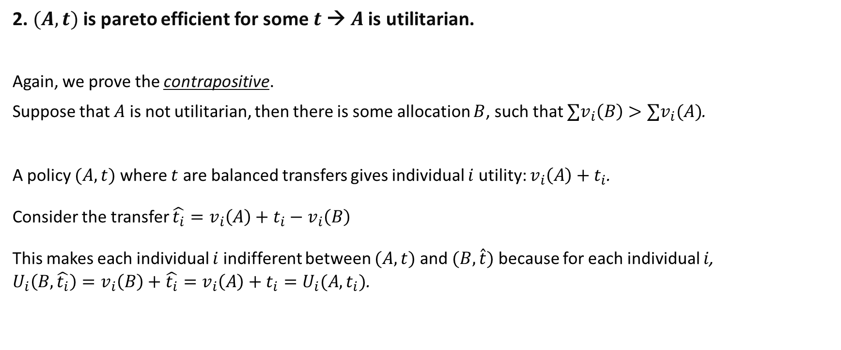
Utilitarianism and Pareto Efficiency with money transfers
2. $(A,t)$ is pareto efficient for some $t \text{→}$ $A$ is utilitarian.
Again, we prove the contrapositive.
Suppose that $A$ is not utilitarian, then there is some allocation $B$, such that $∑v_{i}\left(B\right)>∑v_{i}(A)$.
A policy $(A,t)$ where $t$ are balanced transfers gives individual $i$ utility: $v_{i}\left(A\right)+t_{i}$.
Consider the transfer $\hat{t_{i}}=v_{i}\left(A\right)+t_{i}−v_{i}\left(B\right)$
This makes each individual $i$ indifferent between $(A,t)$ and $(B,\hat{t})$ because for each individual $i$, ${U_{i}\left(B, \hat{t_{i}}\right)=v}_{i}\left(B\right)+\hat{t_{i}}=v_{i}\left(A\right)+t_{i}=U_{i}(A,t_{i})$.

Slide 34
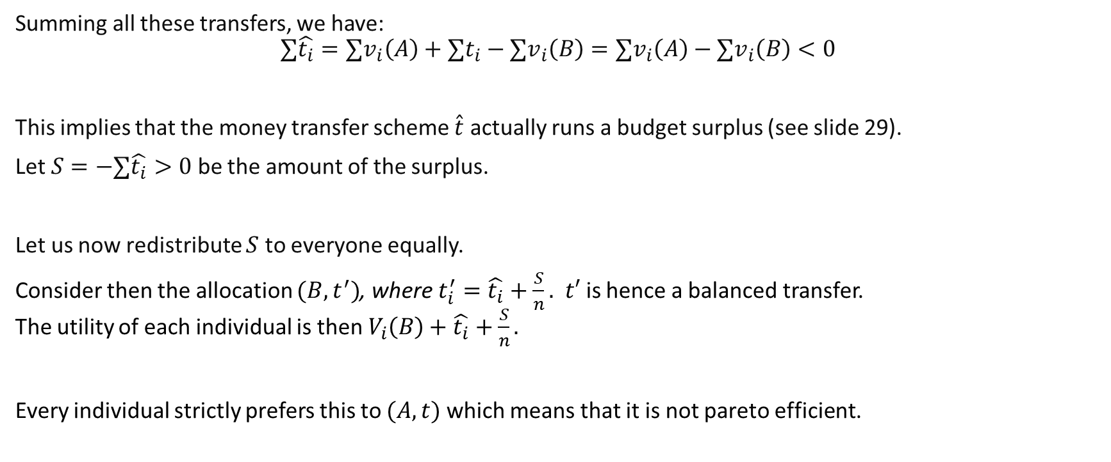
Utilitarianism and Pareto Efficiency with money transfers
Summing all these transfers, we have: $$∑\hat{t_{i}}={∑v}_{i}\left(A\right)+∑t_{i}−{∑v}_{i}\left(B\right)={∑v}_{i}\left(A\right)−{∑v}_{i}\left(B\right)<0$$
This implies that the money transfer scheme $\hat{t}$ actually runs a budget surplus (see slide 29).
Let $S=−∑\hat{t_{i}}>0$ be the amount of the surplus.
Let us now redistribute $S$ to everyone equally.
Consider then the allocation $(B,t^{′})$, where $t_{i}^{′}=\hat{t_{i}}+\frac{S}{n}.$ $t′$ is hence a balanced transfer. The utility of each individual is then $V_{i}\left(B\right)+\hat{t_{i}}+\frac{S}{n}.$
Every individual strictly prefers this to $(A,t)$ which means that it is not pareto efficient.

Slide 35
Intuitively what is going on?

Slide 36

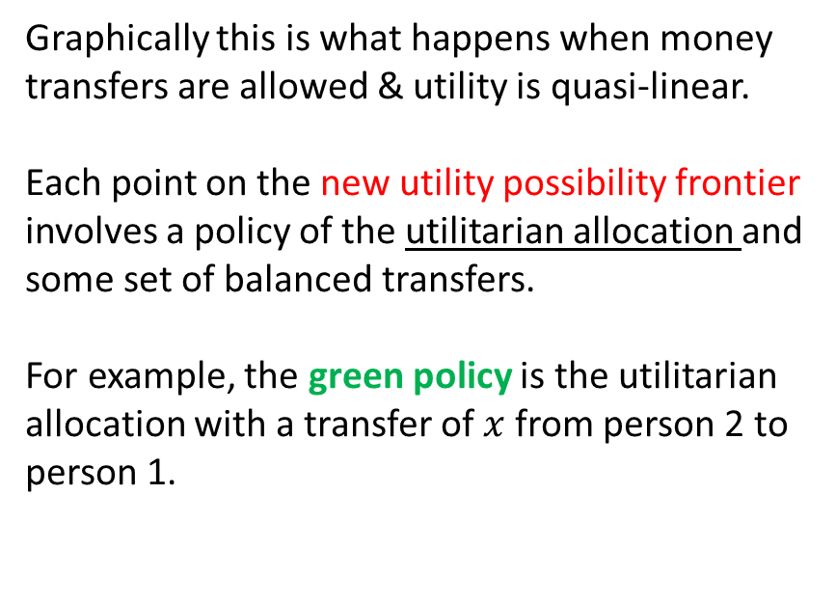



Discussion
Graphically this is what happens when money transfers are allowed & utility is quasi-linear.
Each point on the new utility possibility frontier involves a policy of the utilitarian allocation and some set of balanced transfers.
For example, the green policy is the utilitarian allocation with a transfer of $x$ from person 2 to person 1.
$$U_{1}$$
Utility possibility Frontier (w transfers)
$$t_{1}=x$$
Utilitarian allocation
$$t_{2}=−x$$
Utility possibility Frontier (w/o transfers)
$$U_{2}$$
Notes:
The new utility possibility frontier is just U1+U2 = Utilitarian sum of utilities.

Slide 37
Discussion
Any point on old utility possibility frontier (which involves different allocations) is pareto improved on by a point on the new one, even allowing for balanced transfers.
$$U_{1}$$
Utility possibility Frontier (w transfers)
Utilitarian allocation
Utility possibility Frontier (w/o transfers)
$$U_{2}$$

Slide 38
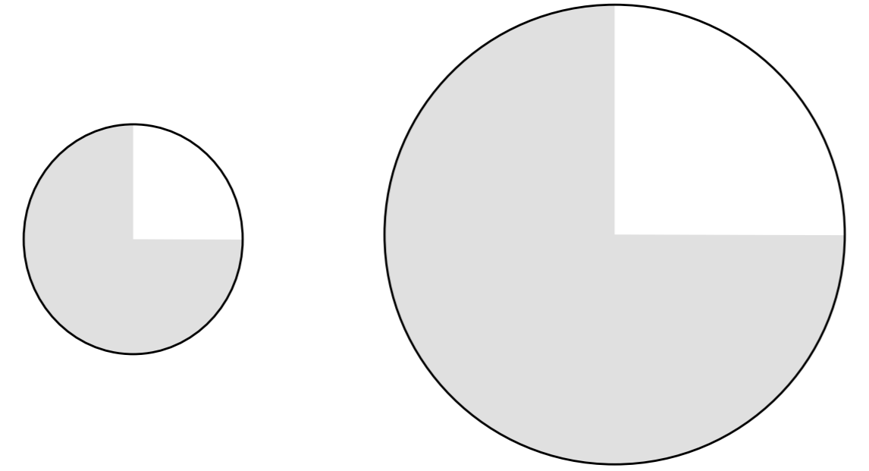
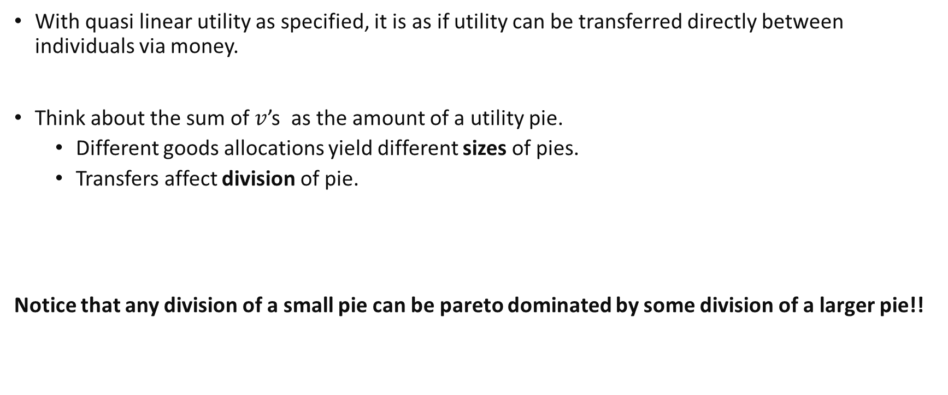
Discussion
With quasi linear utility as specified, it is as if utility can be transferred directly between individuals via money.
Think about the sum of $v$’s as the amount of a utility pie.
Different goods allocations yield different sizes of pies.
Transfers affect division of pie.
Notice that any division of a small pie can be pareto dominated by some division of a larger pie!!

Slide 39
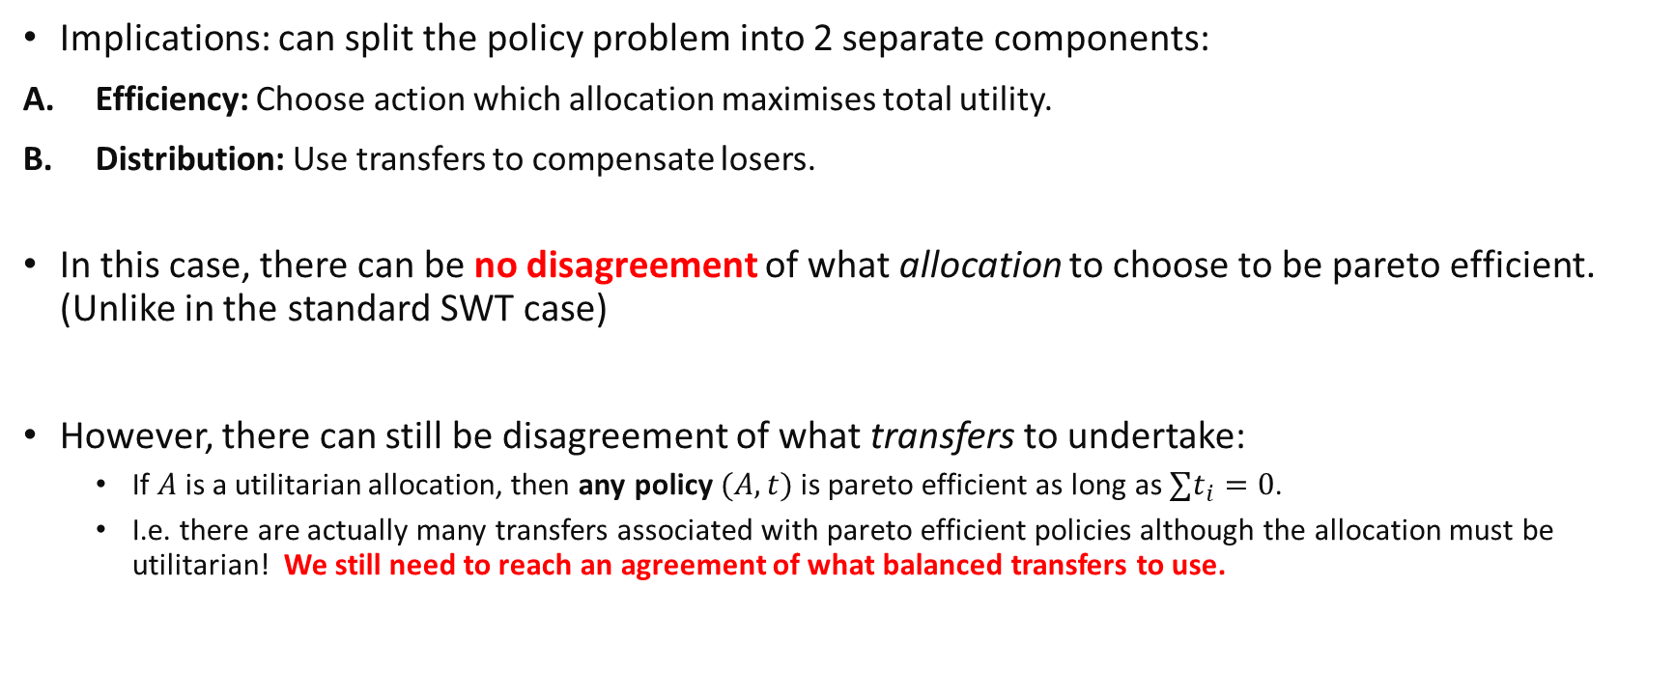
Discussion
Implications: can split the policy problem into 2 separate components:
Efficiency: Choose action which allocation maximises total utility.
Distribution: Use transfers to compensate losers.
In this case, there can be no disagreement of what allocation to choose to be pareto efficient. (Unlike in the standard SWT case)
However, there can still be disagreement of what transfers to undertake:
If $A$ is a utilitarian allocation, then any policy $(A,t)$ is pareto efficient as long as $∑t_{i}=0$.
I.e. there are actually many transfers associated with pareto efficient policies although the allocation must be utilitarian! We still need to reach an agreement of what balanced transfers to use.
Notes:
This is somewhat of an improvement compared to the case where we have to decide what kind of SWF to base our choice of allocation on.
I.e. can take action first and think about addressing consequences later.
If one believes in Rawlsian principles, can apply this to the ex-post utility after transfers.

Slide 40
Discussion
Note that the transfers needed are independent of any prevalent market prices.
They have to be implemented outside the market system.
In a simple case with only 2 individuals, it seems possible for them to come up with some transfers on their own..
However, with many individuals, coordinating on the transfers we need might be difficult.
For example, when shifting from the status quo allocation A to the utilitarian allocation B: Person 1 loses 10 utility and Person 2 loses 5 utility, while Person 3, 4, 5 will gain 2 utility each, Person 6, 7 gain 3 utility each and person 8 gains 6 utility. This will require the “gainers” to arrange simultaneously, transfers to “losers”, which could be difficult.
Notes:
No actual market for trading utility, only goods.

Slide 41
Remarks
Two critical assumptions:
Correct transfers will be chosen
But: technical, informational constraints etc.
Quasi-linear preferences
But: does equal amount of money for one person imply equal amount of utility?
Notes:
Are these “close enough” assumptions?

Slide 42
Key Learning Outcomes
How to apply mathematical logic to simple conditional statements, their contrapositive and converse.
Understand how mathematical logic can be applied to prove the economic statements in the lecture.
Under what conditions is targeting utilitarian outcomes the best policy?
Intuitively, why is being utilitarian good for society?
Notes:
Are these “close enough” assumptions?

Slide 43
Announcement
Bisemester Test 2
Week 13, Monday, 10:00am to 11:15am.
Covers material from second half.
Short answer questions with calculations, similar to tutorials.

Slide 44
Thanks!

